Slide 1

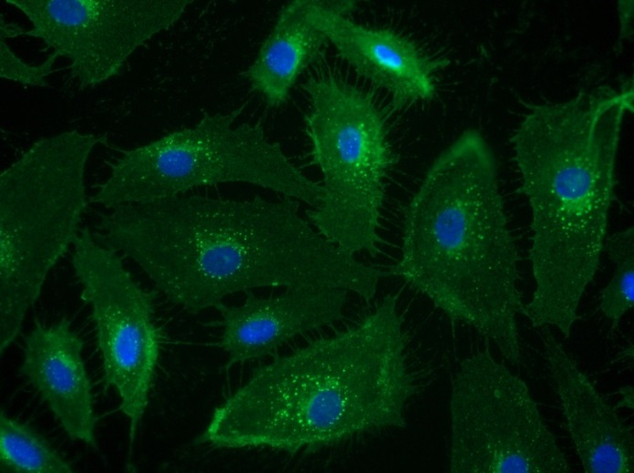
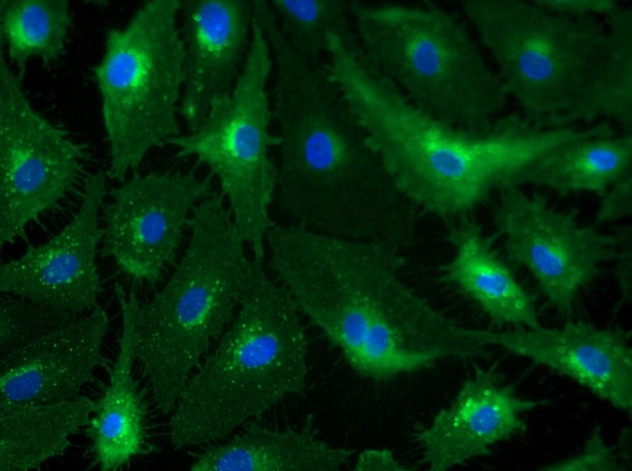
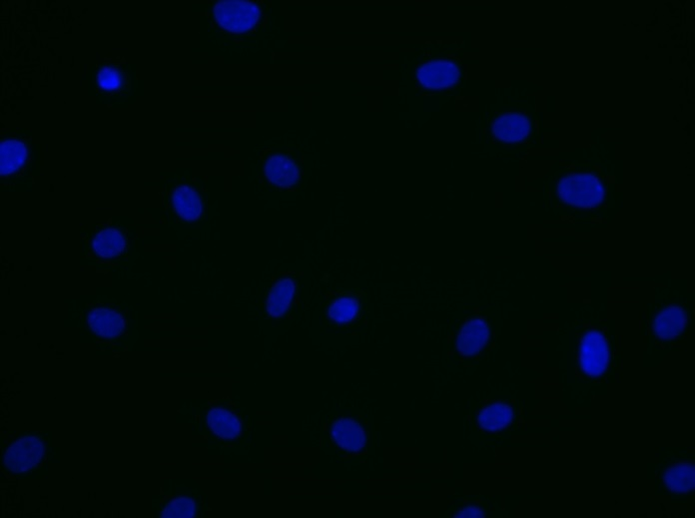
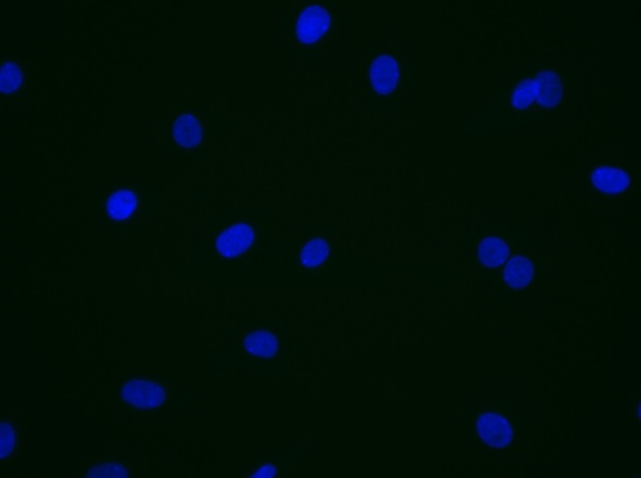
Reliatech GmbH
Rabbit anti-human VEGFR-2/KDR
(Cat# 102-PA18AG [5µg/ml]; HDLEC)
Immunofluorescence staining of human VEGFR-2/KDR (#102-PA22AG) in primary human lymphatic endothelial cells (HDLEC) using a polyclonal antibody directed against the extracellular domain of KDR.
As secondary antibody goat anti-rabbit ALEXA Flour 488 (Dianova; 1:600) was used. [IF_LEC1406-03]
.
rabbit anti-human KDR
rabbit anti-human KDR
Control (goat anti-rabbit IgG ALEXA Flour 488; 1:600)
http://www.reliatech.de / orders@reliatech.de

